Slide 1
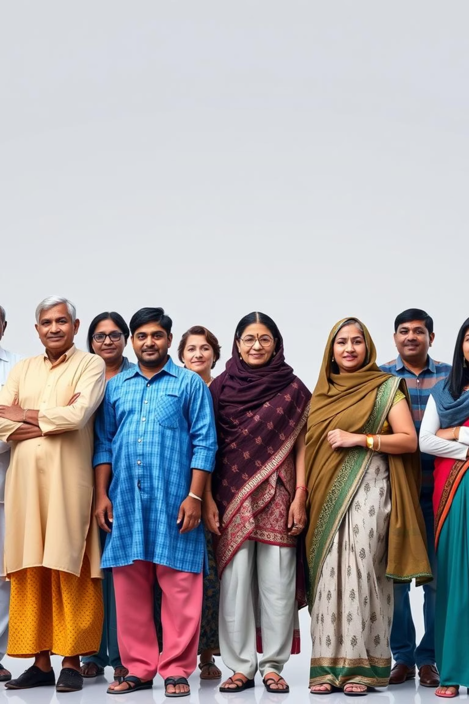
Aarogya Care – AI-Powered Digital Health Record System for All Indians
Aarogya Care is an inclusive, AI-driven health platform that enables every citizen of India to digitally store, access, and share their medical history using a secure QR-based identity: the Aarogya ID. It uses OCR + GPT + QR technology to convert handwritten prescriptions into portable, structured medical records — even in offline-first environments."We can use this ID instead of all our medical certificates."

Slide 2
🧠 The Core Problem: Fragmented Medical Data Systems in India
India currently lacks a unified, accessible system for storing and retrieving a citizen’s medical history — such as diagnoses, prescriptions, and reports. This leads to significant challenges in healthcare delivery.
⚠ Consequences of Disconnected Data
Adverse Outcomes
Patients visit hospitals or clinics with no prior medical data
🩺 Misdiagnosis
Doctors have no access to past reports or prescriptions
💸 Duplicate testing
Chronic patients and the elderly often forget or miscommunicate their treatments
🕒 Wasted time
❌ Poor treatment outcomes
Each medical visit becomes an isolated event, not part of a connected journey

Slide 3

🔑 What India Needs: A Unified Health Identity
Just like Aadhaar provides a unique identity for every citizen, India needs a health equivalent — a single, secure ID to access one’s complete medical history anywhere, anytime. This universal identifier is crucial for bridging the gaps in healthcare data management and ensuring continuous, informed patient care across the nation.

Slide 4
🪪 Introducing Aarogya ID – The Digital Health Identifier
With Aarogya Care, every citizen receives a unique Aarogya ID — a digital health identifier that securely stores their verified medical summaries, prescriptions, and past visit history. This ID revolutionises how health information is accessed and shared.
📱 Seamless Sharing
🧑‍⚕ Instant Access for Professionals
Patients can share their Aarogya ID number instead of carrying cumbersome physical files, streamlining their healthcare visits.
Doctors and hospitals can instantly access comprehensive health records with a simple scan, enabling faster and more informed decision-making.
🧾 Eliminates Physical Documentation
🔐 Privacy and Security by Design
No need to carry physical reports or struggle to remember past diagnoses, reducing administrative burden and patient stress.
All data is privacy-first and securely synced, ensuring patient confidentiality and data integrity.

Slide 5

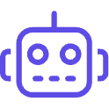



💡 Our Solution: Aarogya Care - AI-Powered Digital Health
Aarogya Care is a lightweight, AI-powered, mobile-first health platform designed to democratise access to structured medical records across India. It simplifies the transition from traditional, paper-based systems to a seamless digital ecosystem.
📸 Accepts Handwritten Prescriptions
🤖 OCR + GPT for Data Extraction
🪪 QR-Based Aarogya ID
Easily upload prescription photos via the mobile app or website, converting physical documents into digital data.
Utilises advanced OCR + GPT technology to accurately extract and summarise key medical details like diagnosis, medicines, doctor name, and date of visit.
Generates a unique QR-based Aarogya ID for each patient, linking directly to their consolidated medical history.
🌐 Mobile-First & Accessible
🔌 Offline-First Functionality
Available via a user-friendly mobile app and website, ensuring broad accessibility for every Indian, regardless of region or tech literacy.
Supports offline-first usage, allowing data entry even without internet connectivity and securely syncing when reconnected.

Slide 6
🔄 How It Works: A Seamless Digital Workflow
Aarogya Care simplifies the process of digitalising medical records into a few intuitive steps, ensuring ease of use for both patients and healthcare providers.
📸 Upload Prescription
1
The user uploads a clear photo of their handwritten prescription via the Aarogya Care mobile app or website.
🧠 AI Extracts Details
2
Our AI engine, powered by OCR + GPT, processes the image to accurately extract and structure key medical details.
🪪 QR Code Generated
3
A unique QR code (Aarogya ID) is generated, securely linked to the patient's summarised medical history.
🧑‍⚕ Doctor Scans QR
4
Doctors can scan the QR to instantly access the patient's comprehensive medical history, facilitating informed care.
📶 Offline Capability
5
The system functions seamlessly even offline, with all data securely syncing to the cloud once an internet connection is available.

Slide 7
🏆 Key Features of Aarogya Care
🧠 AI-Powered OCR + GPT
Summarises complex handwritten prescriptions into structured digital data, ensuring accuracy and readability.
🧾 QR Health ID
Patients carry a scannable digital health identity, replacing physical documents and enabling quick access to records.
🔌 Offline-First
Functions effectively without constant internet access, crucial for remote areas, and syncs securely later.
🔐 Privacy & Control
Patient data is encrypted and user-controlled, adhering to strict privacy protocols and ensuring data security.
🏥 Doctor-Friendly
Provides instant, summarised patient histories, empowering healthcare professionals with fast and informed decision-making.
🌍 Scalable Design
Built to integrate seamlessly with existing public health schemes like Ayushman Bharat, ensuring nationwide impact.

Slide 8

🌟 Why Aarogya Care Is a Game-Changer
⚡ Transforms Scattered Prescriptions into Smart Health History: Converts chaotic paper records into organised, accessible digital formats.
✅ Solves Misdiagnosis and Duplication Across All Healthcare Levels: Provides a unified view of patient history, reducing errors and redundant tests.
📱 Works on Mobile for Accessibility, Even Offline: Ensures healthcare data is available to everyone, everywhere, regardless of connectivity.
🧑‍⚕ Empowers Doctors with Instant Medical Summaries: Gives healthcare providers immediate access to critical patient information for better care.
🪪 Aarogya ID Becomes Your All-in-One Health Certificate: A single, secure digital identifier for complete medical records.

Slide 9
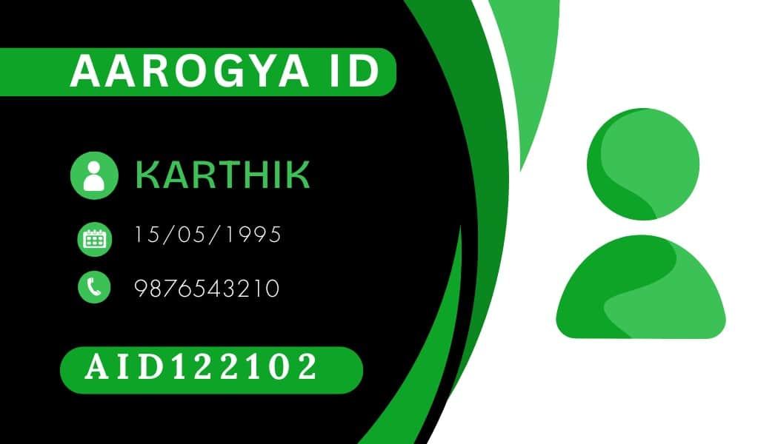
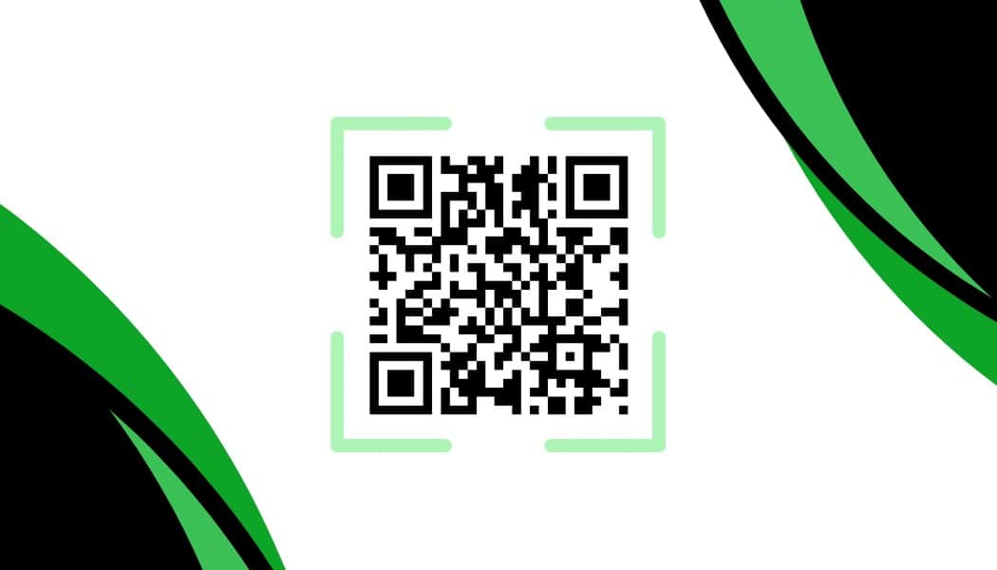
🧪 Experience Aarogya Care: Live Demo and Resources
Explore Aarogya Care in action and gain a deeper understanding of its capabilities. These resources will provide a comprehensive insight into how our platform transforms healthcare record management.
SCAN THIS QR CODE

